Slide 1
Complexity of Algorithmic

Slide 2
§3.3: Algorithmic Complexity
The algorithmic complexity of a computation is, most generally, a measure of how difficult it is to perform the computation.
That is, it measures some aspect of the cost of computation (in a general sense of “cost”).
  Amount of resources required to do a computation.
Some of the most common complexity measures:
  “Time” complexity: # of operations or steps required
  “Space” complexity: # of memory bits req’d
Our focus
School of Computer Science, BUPT

Slide 3
Complexity Depends on Input
Most algorithms have different complexities for inputs of different sizes.
  E.g. searching a long list typically takes more time than searching a short one.
Therefore, complexity is usually expressed as a function of the input length.
  This function usually gives the complexity for the worst-case input of any given length.
School of Computer Science, BUPT

Slide 4
Example 1: Max algorithm
Problem: Find the simplest form of the exact order of growth (Θ) of the worst-case time complexity (w.c.t.c.) of the max algorithm, assuming that each line of code takes some constant time every time it is executed (with possibly different times for different lines of code).
School of Computer Science, BUPT

Slide 5
Complexity analysis of max
procedure max(a₁, a₂, …, a_{n}: integers)
v := a₁ t₁
for i := 2 to n t₂
if a_{i} > v then v := a_{i} t₃
return v t₄
First, what’s an expression for the exact total worst-case time? (Not its order of growth.)
Times for each execution of each line.
School of Computer Science, BUPT

Slide 6
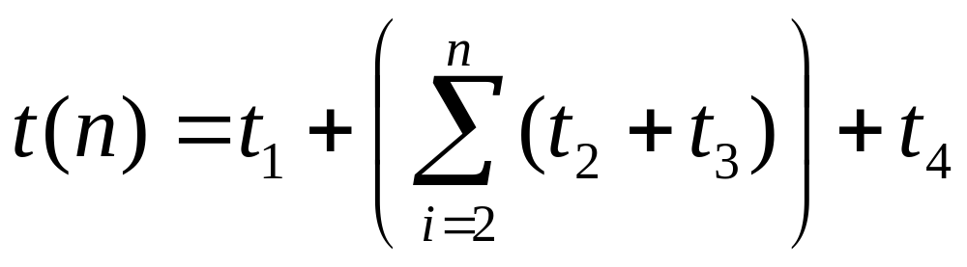
Complexity analysis, cont.
procedure max(a₁, a₂, …, a_{n}: integers)
v := a₁ t₁
for i := 2 to n t₂
if a_{i} > v then v := a_{i} t₃
return v t₄
w.c.t.c.:
Times for each execution of each line.
School of Computer Science, BUPT

Slide 7
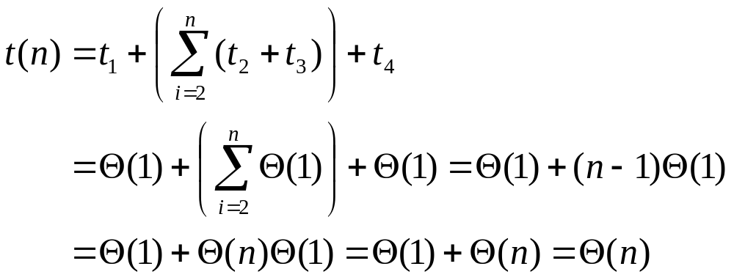
Complexity analysis, cont.
Now, what is the simplest form of the exact (Θ) order of growth of t(n)?
School of Computer Science, BUPT

Slide 8
Example 2: Linear Search
procedure linear search (x: integer,
a₁, a₂, …, a_{n}: distinct integers)
i := 1 t₁
while (i ≤ n ∧ x ≠ a_{i}) t₂
i := i + 1 t₃
if i ≤ n then location := i t₄
else location := 0 t₅
return location t₆
School of Computer Science, BUPT

Slide 9
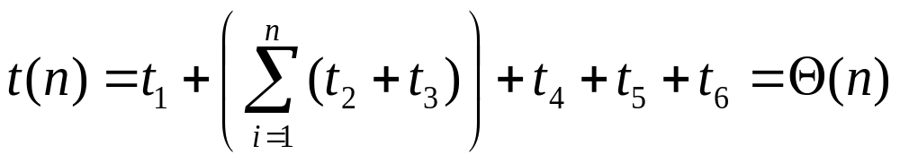
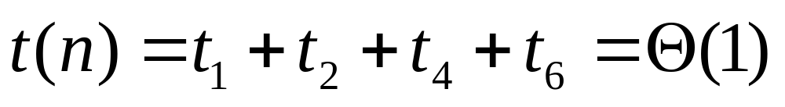
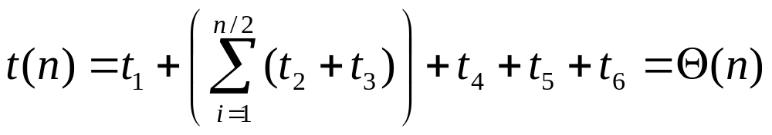
Linear search analysis
Worst case time complexity order:
Best case:
Average case, if item is present:
School of Computer Science, BUPT

Slide 10
Review §3.3: Complexity
Algorithmic complexity = cost of computation.
Focus on time complexity for our course.
  Although space & energy are also important.
Characterize complexity as a function of input size: Worst-case, best-case, or average-case.
Use orders-of-growth notation to concisely summarize the growth properties of complexity functions.
School of Computer Science, BUPT

Slide 11
Example 3: Binary Search
procedure binary search (x:integer, a₁, a₂, …, a_{n}: distinct integers, sorted smallest to largest)
i := 1
j := n
while i<j begin
m := ⎣(i+j)/2⎦
if x>a_{m} then i := m+1 else j := m
end
if x = a_{i} then location := i else location := 0
return location
Key question:
How many loop iterations?
Θ(1)
Θ(1)
Θ(1)
School of Computer Science, BUPT

Slide 12
Binary search analysis
Suppose that n is a power of 2, i.e., ∃k: n=2^{k}.
Original range from i=1 to j=n contains n items.
Each iteration: Size j−i+1 of range is cut in ~half.
Loop terminates when size of range is 1=2⁰ (i=j).
Therefore, the number of iterations is:
k = log₂n = Θ(log₂ n)= Θ(log n)
Even for n≠2^{k} (not an integral power of 2),
time complexity is still Θ(log₂ n) = Θ(log n).
School of Computer Science, BUPT

Slide 13
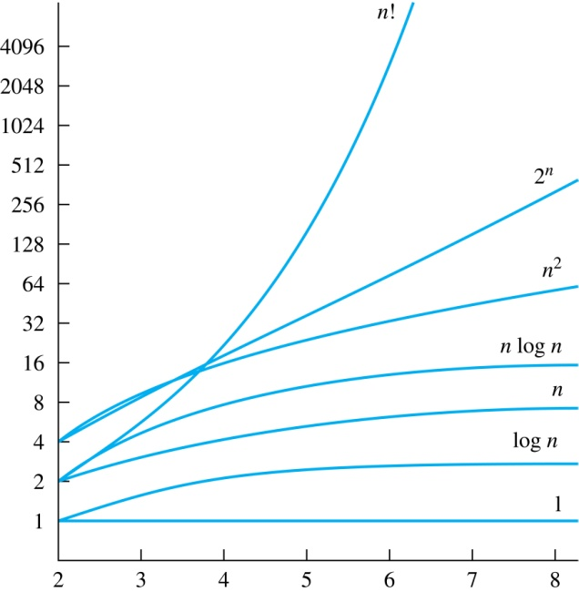
Names for some orders of growth
Θ(1) Constant
Θ(log_{c} n)Logarithmic (same order ∀c)
Θ(log n^{c})Polylogarithmic(With c a constant.)
Θ(n) Linear
Θ(n^{c}) Polynomial (for any c)
Θ(c^{n}) Exponential (for c>1)
Θ(n!) Factorial
School of Computer Science, BUPT

Slide 14
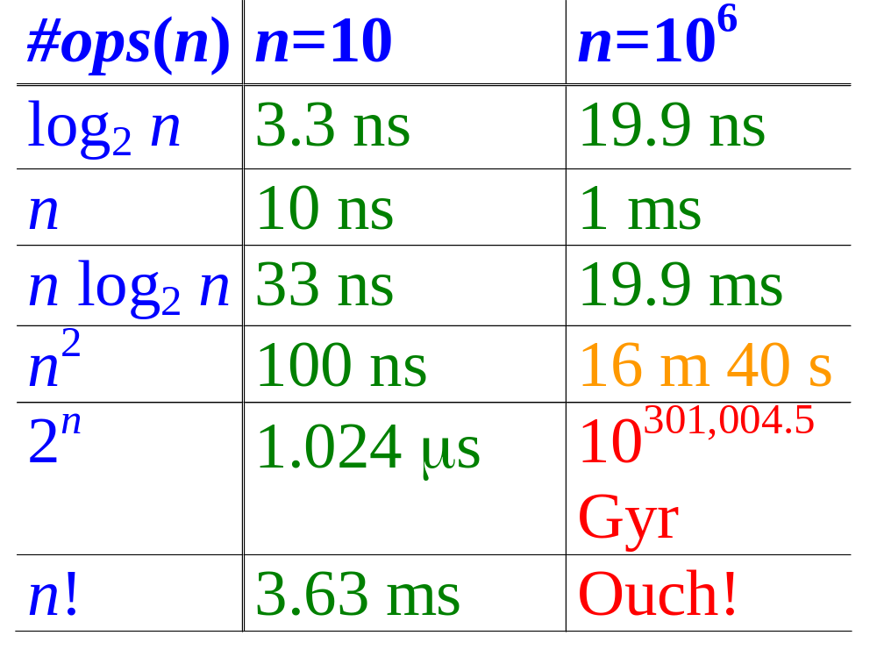
Computer Time Examples
(1.25 bytes)
(125 kB)
Assume time = 1 ns (10⁻⁹ second) per op, problem size = n bits, and #ops is a function of n, as shown.
School of Computer Science, BUPT

Slide 15
Problem Complexity
The complexity of a computational problem or task is (the order of growth of) the complexity of the algorithm with the lowest order of growth of complexity for solving that problem or performing that task.
E.g. the problem of searching an ordered list has at most logarithmic time complexity. (Complexity is O(log n).)
问题复杂度指解决该问题或执行该任务的复杂度增长最低阶的算法的复杂度
School of Computer Science, BUPT

Slide 16
Tractable vs. intractable
A problem or algorithm with at most polynomial time complexity is considered tractable (or feasible). P is the set of all tractable problems.
A problem or algorithm that has complexity greater than polynomial is considered intractable (or infeasible).
Note that n^{1,000,000} is technically tractable, but really very hard. n^{log log log n} is technically intractable, but easy. Such cases are rare though.
School of Computer Science, BUPT

Slide 17
P vs. NP
Definition:
  NP (Nondeterministic Polynomial time) is the set of problems for which there exists a tractable algorithm for checking a proposed solution to tell if it is correct.
    E.g. Eight Queen problem, Sudoku Problem, TSP …..
  We know that P⊆NP.
  But the most famous unproven conjecture in computer science is that this inclusion is proper.
  i.e., that P⊂NP rather than P=NP.
Whoever first proves or disprove this will be famous!
世界七大数学难题之首: NP=P?
School of Computer Science, BUPT

Slide 18
NP-Complete Problem
Definition:
  NP-Complete problems (NP-C): If some of NP problems can be solved by a polynomial worst-case time algorithm, then all problems in the class NP can be solved by polynomial worst-case time algorithms. (所有NP问题都可以在多项式时间内规约为某些NP问题，这些问题的复杂性与所有NP问题的复杂性相关联，若这些问题存在多项式时间求解算法，则所有NP问题都是多项式时间可解的，这些问题被称为NP-完全问题)
  NPC满足两个条件：
    是一个NP问题。
    其他NP问题能够在多项式时间内规约（转化）为该问题（该问题的复杂度大于原NP问题）。
  NPC示例：可满足性问题、旅行商问题TSP、汉密尔顿回路问题等。
School of Computer Science, BUPT

Slide 19
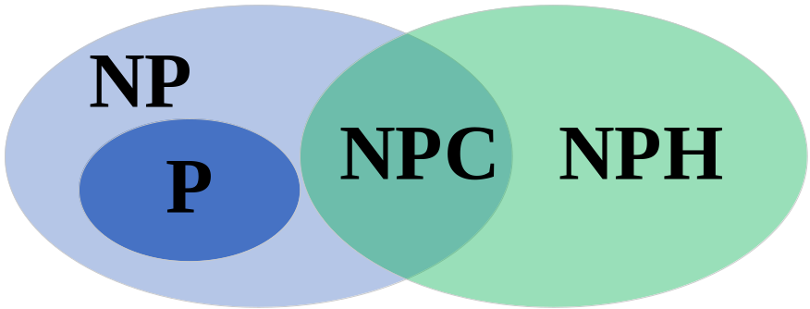
NP-Hard Problem
Definition:
  NP-hard problem (NP-H): NP问题能够在多项式时间内规约（转化）为某个问题X，X的复杂度一般大于原NP问题，若X是一个NP问题，则称X是NPC的，否则X是NP-Hard的。
  NPH问题满足NPC问题的第2个条件但不满足第1个条件，也就是说NPH不一定是NP问题，NPH问题比NPC问题范围广，更难以解决。
假设P≠NP
School of Computer Science, BUPT

Slide 20
Unsolvable problems
Turing discovered in the 1930’s that there are problems unsolvable by any algorithm.
  Or equivalently, there are undecidable yes/no questions, and uncomputable functions.
Classic example: the halting problem.
  Given an arbitrary algorithm and its input, will that algorithm eventually halt, or will it continue forever in an “infinite loop?”
School of Computer Science, BUPT

Slide 21
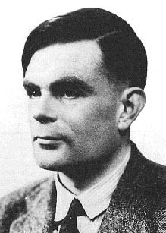
The Halting Problem (Turing’36)
The halting problem was the first mathematical
function proven to have no algorithm that
computes it!
  We say, it is uncomputable.
The desired function is Halts(P,I) :≡ the truth
value of this statement:
  “Program P, given input I, eventually terminates.”
Theorem: Halts is uncomputable!
  I.e., there does not exist any algorithm A that
  computes Halts correctly for all possible inputs.
Its proof is thus a non-existence proof.
Corollary: General impossibility of predictive analysis of arbitrary computer programs.
Alan Turing
1912-1954
School of Computer Science, BUPT

Slide 22
Halting Problem
Example: Can we develop a procedure that takes as input a computer program along with its input and determines whether the program will eventually halt with that input.
Solution: Proof by contradiction.
Assume that there is such a procedure and call it H(P,I). The procedure H(P,I) takes as input a program P and the input I to P.
  H outputs “halt” if it is the case that P will stop when run with input I.
  Otherwise, H outputs “loops forever.”

Slide 23
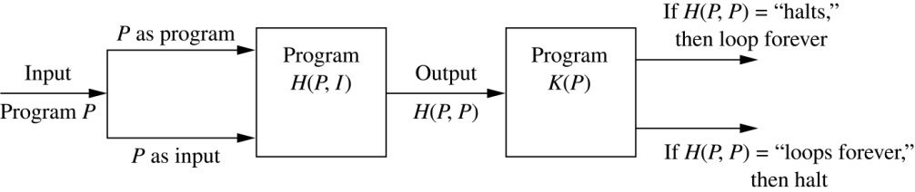
Halting Problem
Since a program is a string of characters, we can call H(P,P). Construct a procedure K(P), which works as follows.
  If H(P,P) outputs “loops forever” then K(P) halts.
  If H(P,P) outputs “halt” then K(P) goes into an infinite loop printing “ha” on each iteration.

Slide 24
Halting Problem
Now we call K with K as input, i.e. K(K).
  If the output of H(K,K) is “loops forever” then K(K) halts. A Contradiction.
  If the output of H(K,K) is “halts” then K(K) loops forever. A Contradiction.
Therefore, there can not be a procedure that can decide whether or not an arbitrary program halts. The halting problem is unsolvable.
Corollary:
  General impossibility of predictive analysis of arbitrary computer programs (对任意计算机程序进行预测分析一般是不可能的).

Slide 25
Key Things to Know
Definitions of algorithmic complexity, time complexity, worst-case time complexity.
Names of specific orders of growth of complexity.
How to analyze the worst case, best case, or average case order of growth of time complexity for simple algorithms.
School of Computer Science, BUPT

Slide 26
Complexity class
The equivalence classes of Θ (complexity class) consist of functions that have the same order.
  Θ(g) is the equivalence class of Θ that g belongs to.
f ∈ Θ(g) iff f and g have same order.
School of Computer Science, BUPT

Slide 27
Important Complexity Classes
The most common orders in computer science applications are
  Θ(1), Θ(n) , Θ(n²) , Θ(n³)
  Θ(lgn) , Θ(nlgn)
  Θ(2^{n})
Some Terms
  constant time O(1)
  logarithmic time O(lg n)
  linear time O(n)
  quadratic time O(n²)
  polynomial time O(n^{c})
  exponential time O(c^{n})
School of Computer Science, BUPT

Slide 28
Rules for determining the Θ-Class of a Function
Θ(1) functions are constant and have zero growth.
Θ(lg(n)) is lower than Θ(n^{k}) if k>0.
Θ(nª) is lower than Θ(n^{b}) if and only if 0<a<b.
Θ(a^{n}) is lower than Θ(b^{n}) if and only if 0<a<b.
Θ(n^{k}) is lower than Θ(a^{n}) for any power of n^{k} and any a>1.
Θ(a^{n}) is lower than Θ(n!) for any a>1.
Θ(n!) is lower than Θ(n^{n})
If r is not zero, then Θ(rf) = Θ(f) for any function f.
If h is a nonzero function and Θ(f) is lower than (or same order as) Θ(g), then Θ(fh) is lower than (or same order as) Θ(gh).
If Θ(f) is lower than Θ(g), then Θ(f+g)= Θ(g).
School of Computer Science, BUPT

Slide 29
Homework
§3.3
  40
School of Computer Science, BUPT

Slide 30
Please feel free
to ask questions!
((( )))
School of Computer Science, BUPT

